Slide 1

COLLEGE ERP
Project PResentation SUBMITTED BY:
Name: S.SUDHARSHAN
REGISTER NO: 112418621337
DEPARTMENT: MCA
COLLEGE: SRI VENKATESWARA COLLEGE OF ENGINEERING AND TECHNOLOGY
UNIVERSITY: ANNA UNIVERSITY

Slide 2

CONTENTS
INTRODUCTION
OBJECTIVES
SCOPE
PRODUCT PERSPECTIVE
PRODUCT FEATURES
SYSTEM REQUIREMENTS
FUNCTIONS
SOFTWARE QUALITY ATTRIBUTES
SYSTEM DESIGN
USE CASE DIAGRAM
ARCHITECTUAL DESIGN
SYSTEM TESTING AND RESULT ANALYSIS
SCREENSHOTS
CONCLUSION

Slide 3
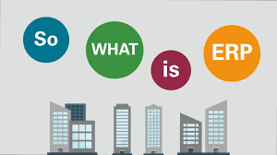
INTRODUCTION
Enterprise Resource Planning system, is also known as ERP system.
ERP system has become very popular as an enterprise management software tool.
In fact, ERP systems are used in almost any type of organization – large or small scale industries.
In today’s competitive business world usage of ERP systems is becoming a must for any educational organization to meet the challenges faced in their business process and facing numerous problems in their internal processing like attendance management, payroll management, quick decision making, etc.
The main purpose of this project is to illustrate the organization to maintain and manage personal data.
This reduces data error and ensures that information is always up-to-date.

Slide 4

OBJECTIVES
The objective of the College Information Management System is allow the administrator of any organization the ability to edit and find out the personal details of a student and allows the student to keep up-to-date his/her profile.
It’s also facilitate keeping all the records of students, such as their id, name, mailing address, phone number, DOB, etc.
Overall, it’ll make Student Information an easier job for the administrator and the student of any organizations.

Slide 5

SCOPE
College management is becoming a very essential component in education in this modern-day age.
With the help of the College Automation System, we can gather all the useful information needed for the management in a few clicks.
The College ERP system now computerized all the details that are maintained manually.
Once the details are fed into the system or computer there is no need for various persons to deal with separate sections.
Only a person is enough to maintain all the reports and records.
The security can also be given as per the user requirement.

Slide 6

PRODUCT PERSPECTIVE
ERP means the techniques and concepts for integrated management of the business as a whole, from the viewpoint of effective use of management resources to improve the efficiency of enterprise management.
A fully integrated web-based ERP will capture and create accurate, consistent, and timely relevant data, and assist in intelligent business decision-making.
It reduces data error, ensures that information is managed efficiently and is always up-to-date.
It is made after extensive study of all the departments like a student, faculty, etc of colleges and is provided with extract of everything a college requires for their database handling, department management, and student/staff management.

Slide 7

PRODUCT FEATURES
Each teacher will be able to enter attendance and marks for their respective students.
Each student will be able to view the attendance status for their respective courses.
The teachers will be able to apply for various types of leave directly through the system.
The students will have access to a forum page where they communicate with each other.
The administrator will be able to view and update information such as departments, classes, teachers, students, courses.

Slide 8
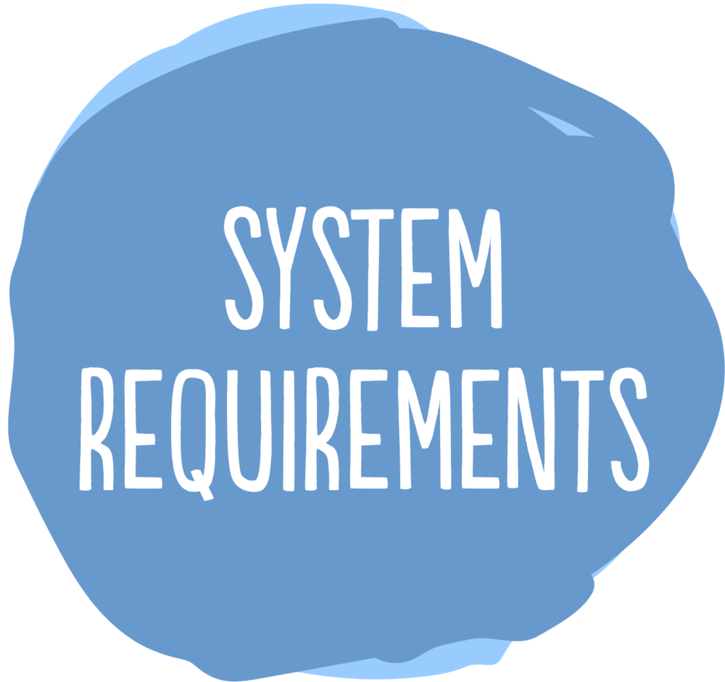

SYSTEM REQUIREMENTS
Operating System: Windows 10
Processor: Intel Core i3
RAM: 4GB
Front-end: HTML/CSS
Back-end: Python/JavaScript
Framework: Bootstrap/Django
Database: MySQL/SQLite3
Tools: Visual Studio Code

Slide 9
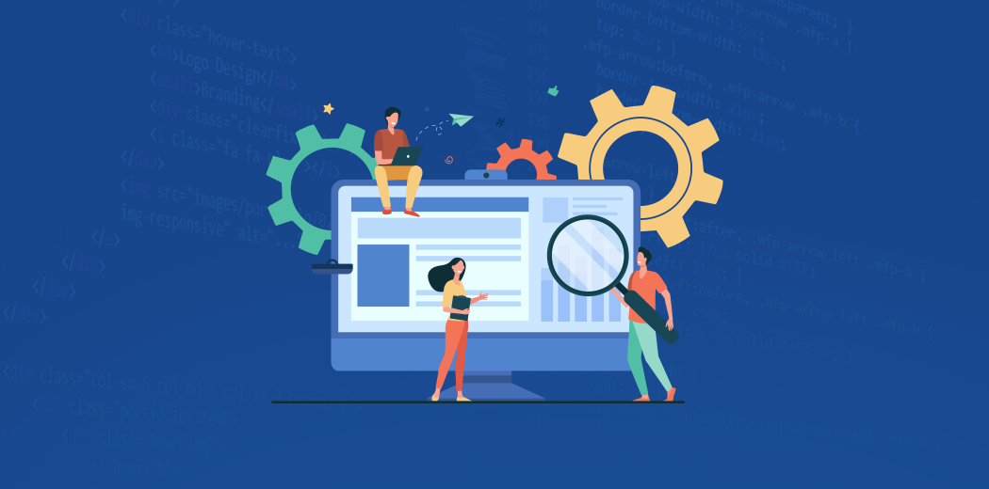
FUNCTIONS
For Students
For Teachers
View Attendance Page
View Marks Page
View Timetable
Entering Attendance
Editing Attendance
Entering Marks
Editing Marks
View Timetable
View Reports

Slide 10

SOFTWARE QUALITY ATTRIBUTES
Availability: User can view their information to keep track regularly.
Correctness: Information about attendance and marks must be correct to not feed wrong information to the users.
Portability: Portable to all platforms, user experience must be optimal.

Slide 11
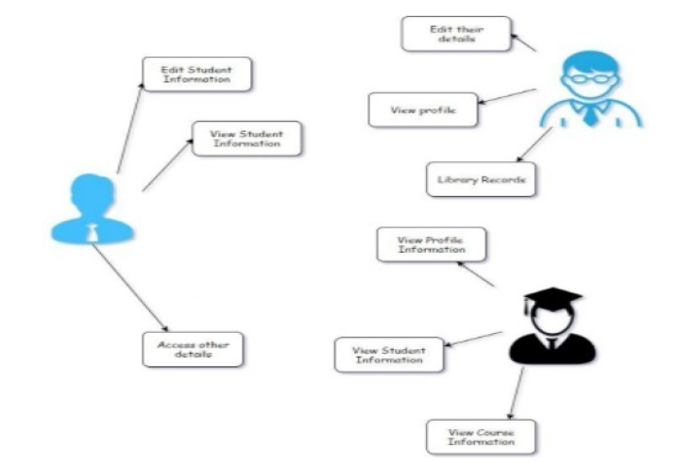
SYSTEM DESIGN

Slide 12
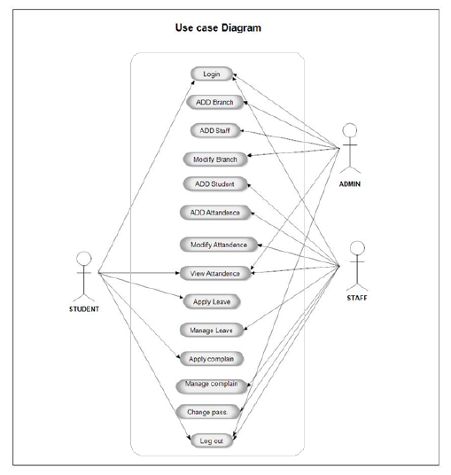
USE CASE DIAGRAM OF COLLEGE ERP

Slide 13
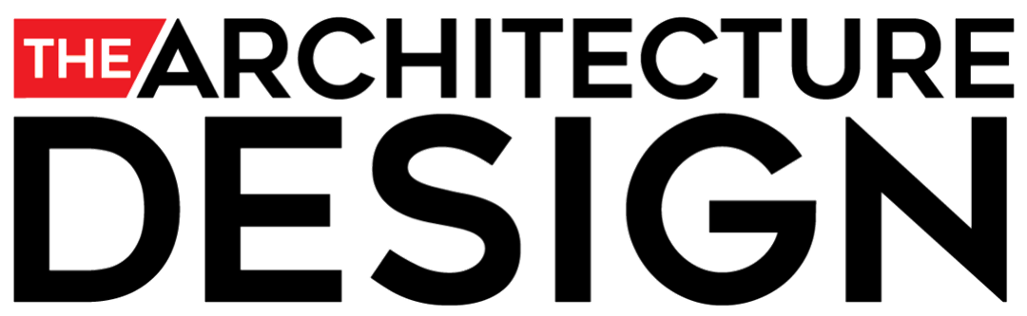
ARCHITECTURAL DESIGN
The ERP software requires the architectural design to represent the design of the software.
We define a collection of hardware and software components and their interfaces to establish the framework for the development of this software.
There exists a number of components of the system which are integrated to form a system.
The set of connectors will help in coordination, communication, and cooperation between the components. The ERP software is built for a computer-based system.
It exhibits the data-centric style of architecture.

Slide 14
ARCHITECTURAL STYLE
Data Centric Architectural Style
In College Erp software, the database stores the data of all the students and faculties and the stored data is updated, added, deleted or modified.
So, it exhibits the data centric architectural style.
In this architecture different components communicate with the shared data repository.
The components access a shared data structure and are relatively independent.
The components are: central data, data accessors, interface

Slide 15
ARCHITECTURE MODEL
There are 3 major categories in which the whole architecture is divided.
These are administrators, staff, and students.
The admin roles are user management, staff management, student management, staff attendance.
Staff and admin performs some common functions like leave management, time table management, exam management.
The role of staff includes attendance entering, student examination management, time table management, leave management.
While the roles of students are profile viewing, view their attendance, and view academic time table.

Slide 16
Generalizing E-college architecture is 3 tiers.
The 3 tiers comprise the presentation layer, application logic layer, and data layer.
Any information System needs to communicate with external entities, human users, or other computers.
The presentation layer allows these entities to interact with the system, it can also be implemented as a GUI interface.
The application layer does more than information delivery, they perform data processing (Business Logic and calculation).

Slide 17

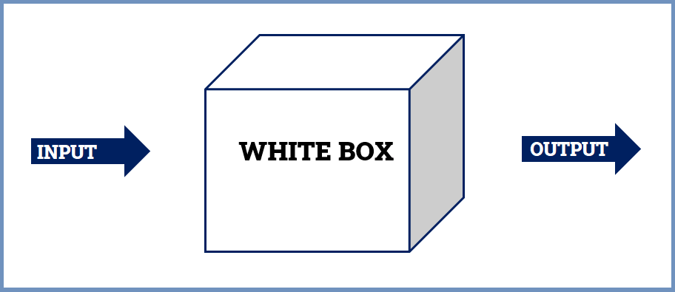
SYSTEM TESTING AND RESULT ANALYSIS
Testing Methods
Software testing methods are traditionally divided into black box testing and while box testing.
These two approaches are used to describe the point of view that a engineer takes when designing test cases.
White Box Testing
White box testing, is when the tester has access to the internal data structure and algorithms.
It can also be used to evaluate the completeness of a test suite that was created with black box testing methods.
The project is implements using Python with Django framework.
The code consists of models and views which can be tested.
Python also provides a file called test.py where we can write unit tests for the models and views.
This is very useful as it automates the testing and we no longer have to manually test every page after there were any changes.

Slide 18
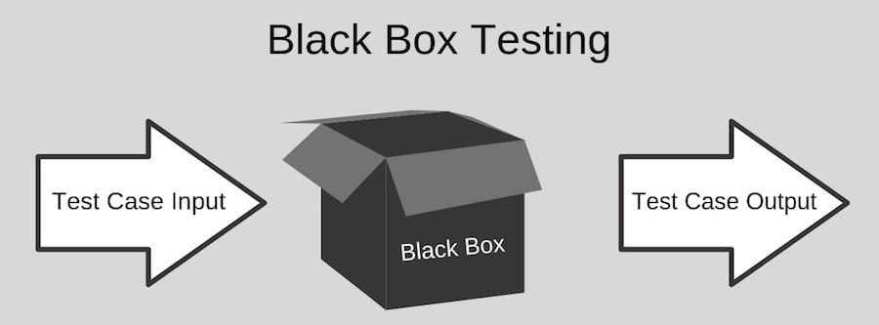

Black Box Testing
Black box testing treats software as a “black box”, without any knowledge of internal implementation.
We performed black box testing on the teacher page was working as desired.
Test Cases:
Request the attendance page for a teacher with no assigned classes
Request the attendance page for a teacher with 1 assigned class
Request to enter the attendance for an assigned class with one test student
Request to edit the attendance for an assigned class with one test student
Request to enter the marks for an assigned class with one student
Request to edit the marks for an assigned class with one student
Request to view the student information for an assigned class with no students
Request to view the student information for an assigned class with 1 student

Slide 19
SCREENSHOTS
STUDENT LOGIN PAGE

Slide 20
STUDENT HOME PAGE

Slide 21
STUDENT ATTENDANCE PAGE

Slide 22
STUDENT ATTENDANCE DETAIL PAGE

Slide 23
STUDENT MARKS PAGE

Slide 24
STUDENT TIME TABLE

Slide 25
TEACHER LOGIN

Slide 26
TEACHER HOMEPAGE

Slide 28
ENTERING ATTENDANCE

Slide 30
EDITING ATTENDANCE

Slide 32
ATTENDANCE OF STUDENTS IN A CLASS

Slide 34
ATTENDANCE DETAILS OF AN INDIVIDUAL STUDENTS

Slide 35
ENTERING MARKS

Slide 36
EDITING MARKS

Slide 38
MARKS OF ALL THE STUDENTS IN A CLASS

Slide 40
TEACHER TIME TABLE

Slide 41
LIST OF FREE TEACHERS FOR TIME SLOT

Slide 42
ATTENDANCE FOR A CLASS OF STUDENTS

Slide 44
ADMIN LOGIN PAGE

Slide 45
ADMIN HOME PAGE

Slide 46
ADMIN STUDENTS TABLE PAGE

Slide 47

CONCLUSION
By using existing system accessing information from files is a difficult task and there is no quick and easy way to keep the records of students and staff.
This system that deals with the issues related to a particular institution.
It is very useful to the student as well as the faculties to have easy access to finding the details.
This project is designing to keeping in view the day to day problems faced by a college system.
This system provides the automatic admissions no manual processing is required.
This is a paperless work.
It can be monitored and controlled remotely. It always provides accurate information.
Hence, this project is successfully implemented with all the features and modules of the college management system as per requirements.

